Slide 1


Slide 2
CLOUD ORCHESTRATION AND INFRASTRUCTURE AUTOMATION
Presented by:
Rudraksh Bhatnagar(500096351)
Piklu De (500096448)
Shubham Jaiswal (500096554 )
Chetanshi Pandey(500096288)
Parth Singh(500096616)
Presented to:
Ms. Avita Katal
Assistant Professor (SS)
Cloud Software Operations Cluster
School of Computer Science

Slide 3
Content
Mid Term Work
Abstract
Introduction 1.1
Introduction 1.2
What are microservices?
How it is different from monolithic
Benefits of Microservices
Problem Statement
Technology stack
Objective
Methodology
Dockerization
Microservices Images
End Term Work
Cloud Platform Selection
Container Orchestration
Deployment Process
Push to Github
Github link
Creating Ci/Cd Pipeline
Deployment using AWS EKS service
Scaling and load balancing
Monitoring and Logging
Team members and their roles

Slide 4
Abstract
In today's rapidly evolving digital landscape, the demand for scalable, resilient, and agile software solutions has led to a fundamental shift in the way applications are designed, developed, and deployed. The advent of microservices architecture and containerization technologies has revolutionized the software development process, empowering organizations to break down complex monolithic applications into smaller, independent, and highly manageable components. This paradigm shift enables faster development cycles, improved scalability, and enhanced fault tolerance. In the heart of this technological transformation lies the synergy between microservices and containers, brought to life in a cloud environment.

Slide 5
1.1)Introduction
In this project-based assignment, we investigated the ideas of microservices, containerization, and their deployment in the cloud environment, we have build a e-commerce system using microservices architecture instead of monolithic architecture, to break down complex applications into smaller, independent, and highly manageable components.
Businesses are continually looking for new methods to provide seamless and scalable online experiences to their customers in today's fast expanding digital market. The introduction of microservices design and containerization technologies has transformed software application development and deployment, notably in the context of e-commerce.
This research, titled "Microservices and Containers Deployment in a Cloud Environment," investigates how these disruptive technologies might be used to build a strong and flexible e-commerce system.

Slide 6
1.2)Introduction
The foundation of our project is made up of five microservices, each precisely developed to handle unique e-commerce functionalities:
Authentication Service: In e-commerce systems, security is critical. The Authentication Service provides strong user authentication and authorisation, protecting sensitive client data and assuring secure platform access.
Product Service: This microservice is in charge of handling the e-commerce platform's product catalogue. It manages product information, price, and availability, ensuring that customers have access to current and accurate product information.
Order Service: The major responsibility of the Order Service is to handle and manage customer orders in a timely and efficient manner. It allows users to browse, add things to their cart, and finalise their purchases, as well as track their orders and receive status updates.
Inventory Service: The Inventory Service monitors product availability and manages inventory levels to guarantee efficient stock management. It is critical in preventing overselling and ensuring a smooth order fulfilment procedure.
Notification Service: It is critical for e-commerce success to keep customers informed and interested. Order confirmations, shipping updates, and promotional messages are handled by the Notification Service, which improves the overall customer experience.

Slide 7
What are Microservices?
Microservices architecture is an architectural style for designing and developing software applications as a collection of small, independent, and loosely coupled services.
It breaks down the application into a set of smaller, self-contained services that can be developed, deployed, and scaled independently.
Each microservice focuses on a specific business capability and communicates with other through well-defined APIs.
It is commonly used in modern software development, especially in large and complex systems where scalability, maintainability, and agility are critical and take advantage of cloud computing and containerization technologies.

Slide 8
 | MONOLITHIC | MICROSERVICES
ARCHITECTURE | Monolithic applications have a single, unified codebase where all components are tightly integrated. | Microservices use a distributed architecture where the application is composed of small, independent services.
SCALABILITY | Scaling a monolithic application usually involves replicating the entire application, which can be inefficient for specific components. | Microservices allow for granular scalability, enabling you to scale only the services that require more resources.
TECH STACK | Limited flexibility in choosing technologies, as the entire application uses a single tech stack. | Offers flexibility in selecting the most suitable technology for each service, enabling innovation and adaptation to specific requirements
COMPLEXITY AND MAINTENANCE | Easier to initially develop and test due to its simplicity. As the application grows, it can become complex and challenging to maintain and update | Initial development may be more complex due to managing multiple services. Easier maintenance and updates, as changes are localized to specific services.
FAULT TOLERANCE | In a monolithic architecture, if one component encounters a fault or error, it can potentially affect the entire application, as all components are tightly integrated. | Microservices offer better fault isolation because each service operates independently. A fault in one service does not necessarily impact others.

Slide 9
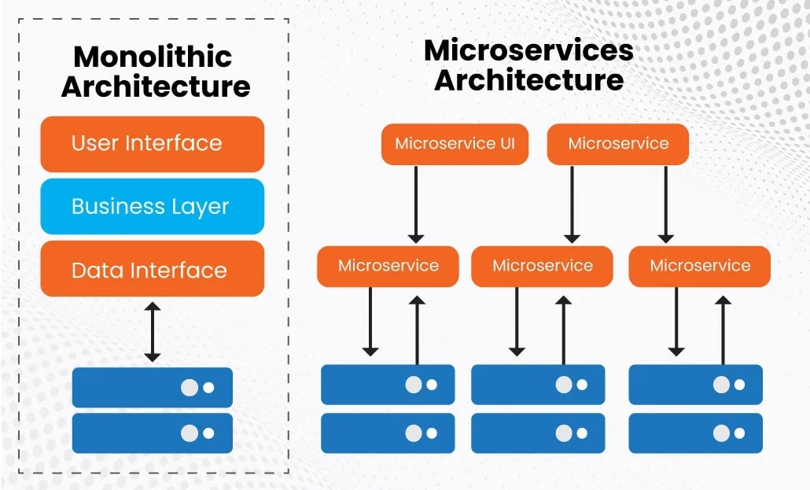

Slide 10
Benefits of Microservices
Scalability: Microservices can be independently scaled based on the specific needs of each service.
Faster Development: Smaller, focused teams can work on individual microservices, leading to faster development cycles.
Technology Stack Flexibility: Microservices architecture allows you to use different programming languages, frameworks, and technologies for each microservice. This flexibility is beneficial if you need to use specialized tools or libraries for specific tasks within the currency converter.
Improved Fault Isolation: If one microservice fails or experiences issues, it typically doesn't affect the entire application. This fault isolation leads to improved system reliability and availability.
Enhanced Maintainability: Smaller codebases are easier to understand, test, and maintain. Developers can focus on one service at a time, making it simpler to troubleshoot issues and implement changes.
Easier Testing: Isolating microservices simplifies testing. You can test each service individually, including unit tests, integration tests, and end-to-end tests, ensuring robust code quality.

Slide 11
Problem Statement
The problem statement for our project, revolves around the challenges and complexities associated with successfully deploying and managing a containerized microservices-based e-commerce system.
Scaling Complexity: Microservices promise scalability, but their implementation involves complexities associated with orchestrating, monitoring, and managing many services.
The challenge is to develop techniques and best practices for seamless scalability while retaining system stability.
Resource Efficiency: Ensuring effective resource utilisation across numerous containerized microservices poses cost-efficiency and performance-optimization difficulties.
Deployment Challenges: Docker containerization is a promising option for consistency and portability, but deploying and coordinating these containers at scale can be difficult.
Security and Compliance: E-commerce systems handle sensitive client data, thus security is critical.
Container vulnerabilities and access control are two additional security problems introduced by containerized microservices.
It is a difficult problem to ensure strong authentication, permission, and data security across microservices.

Slide 12

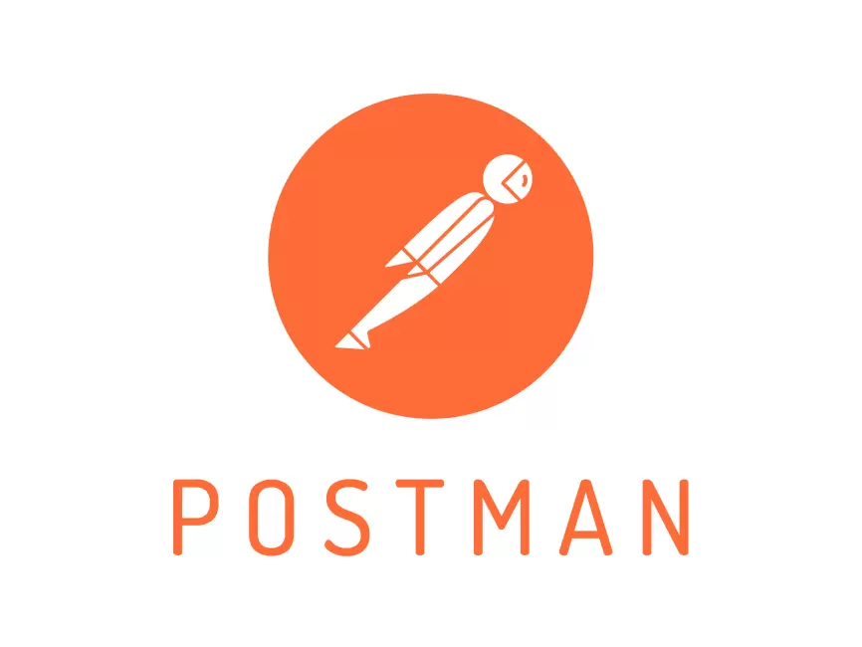

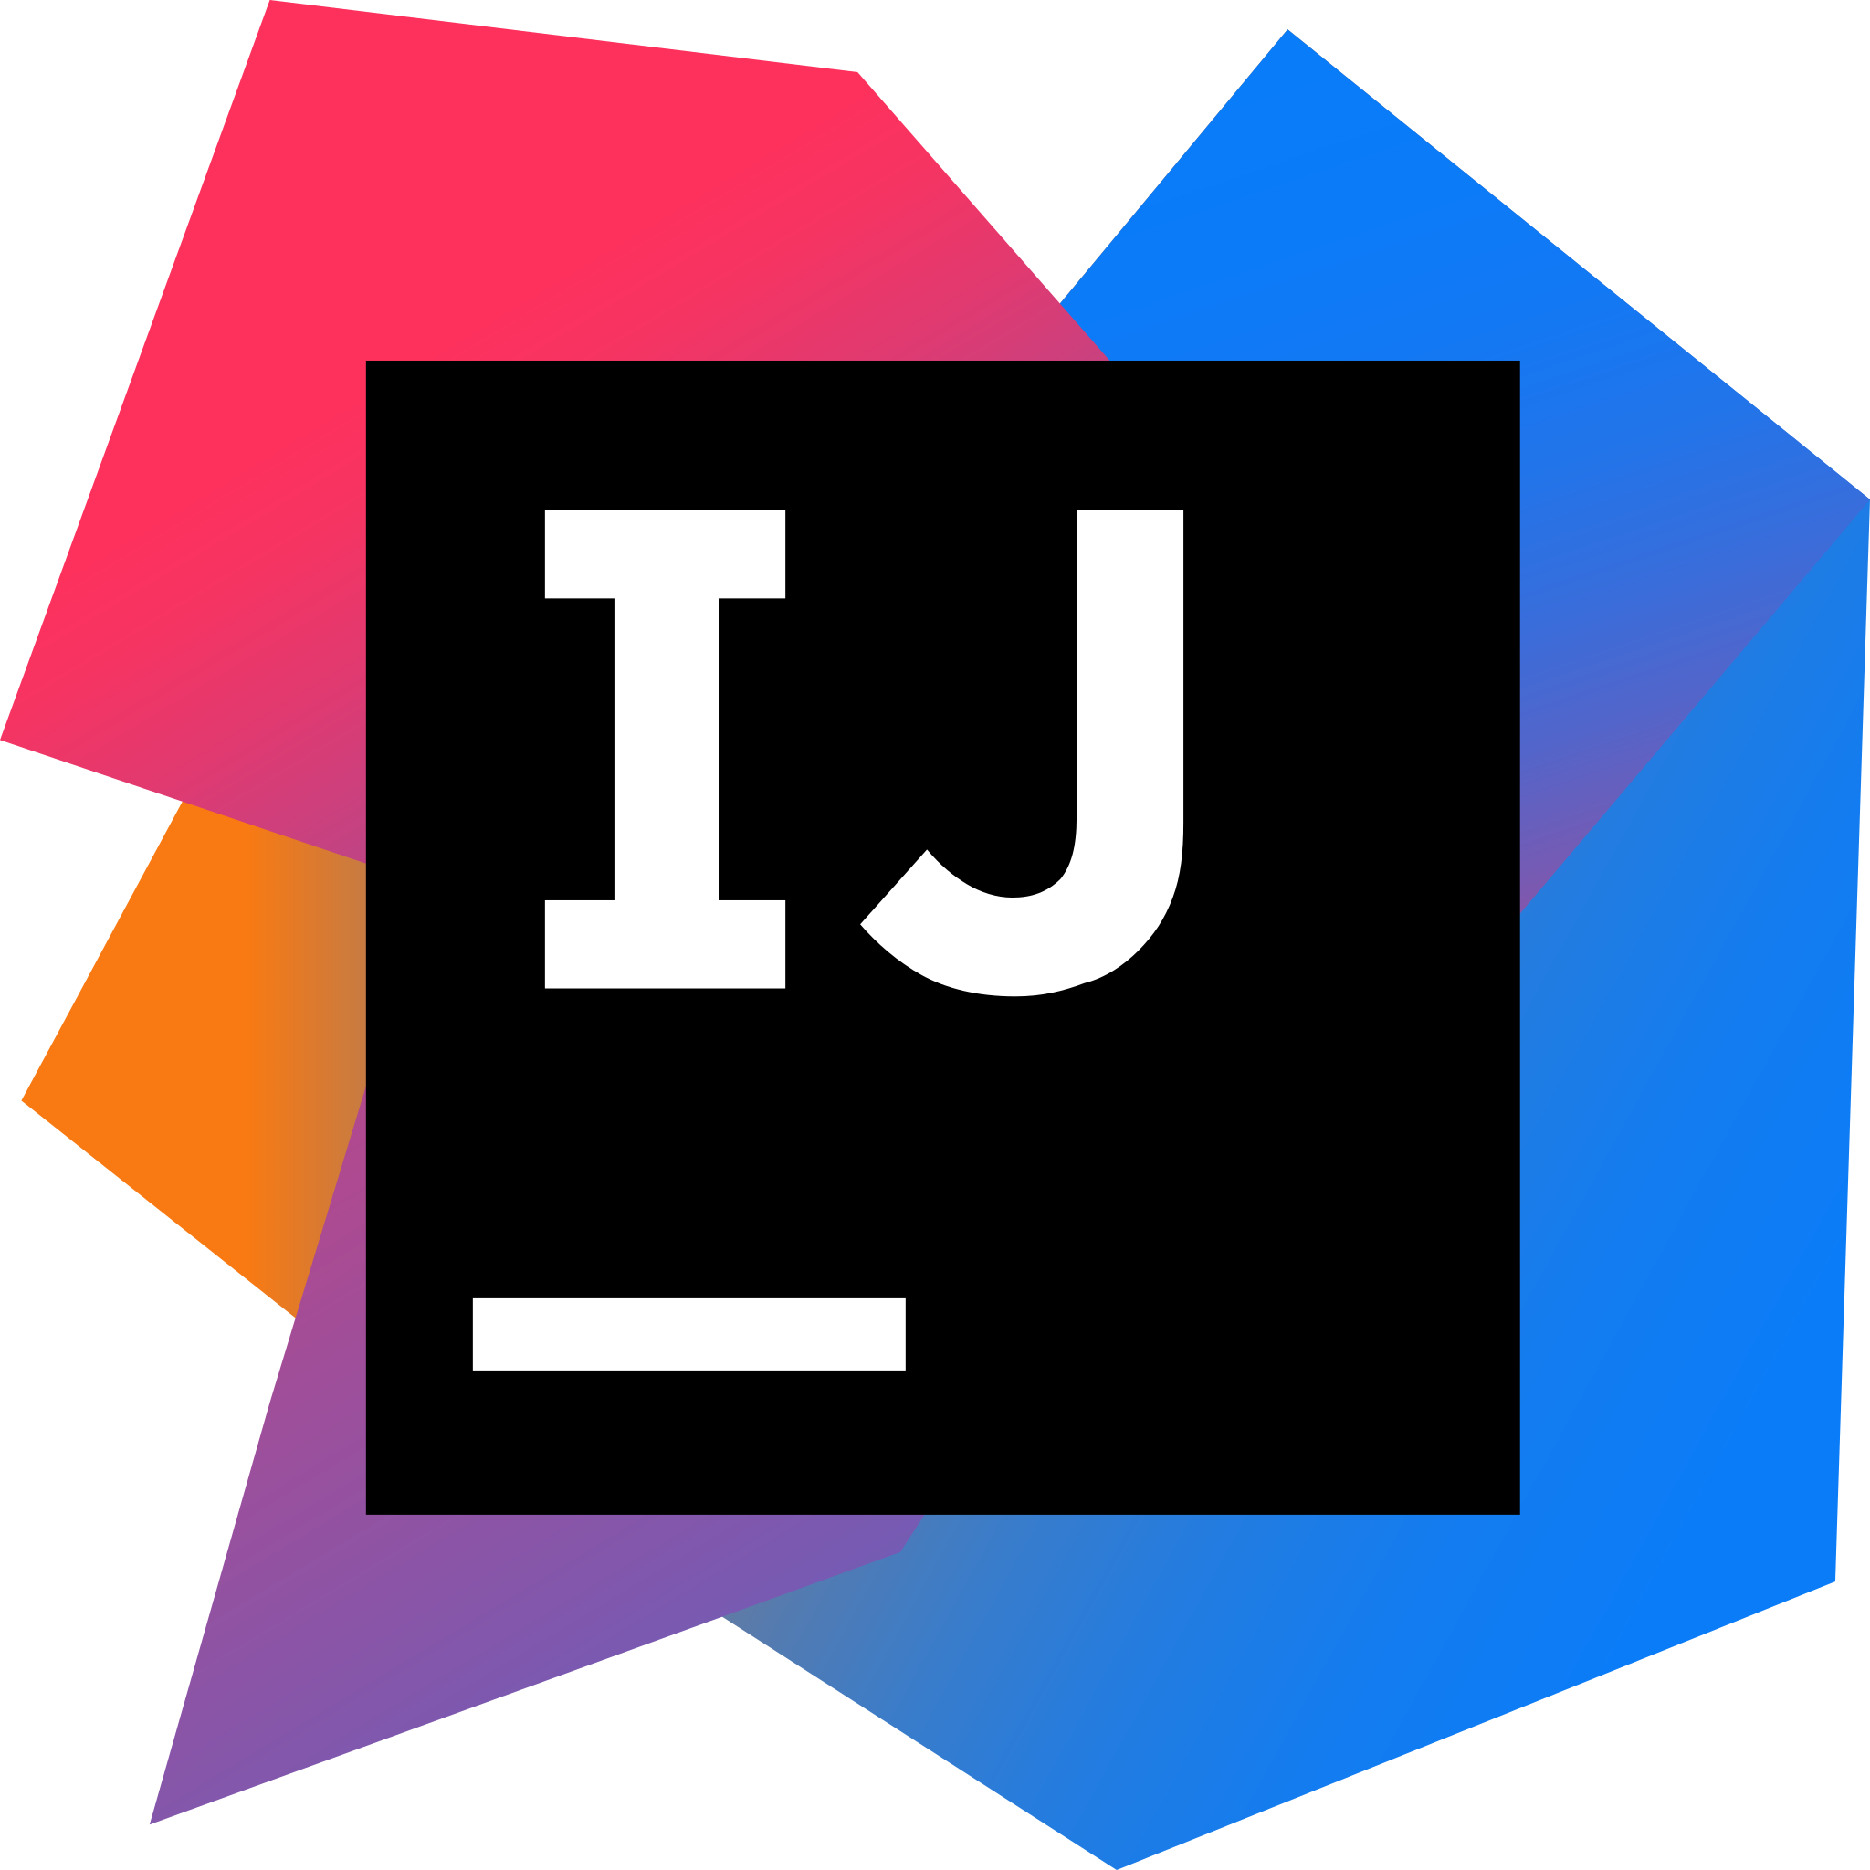
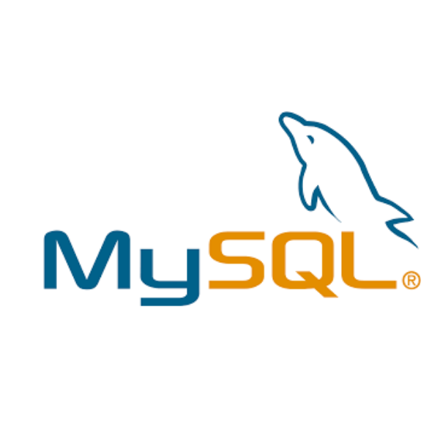


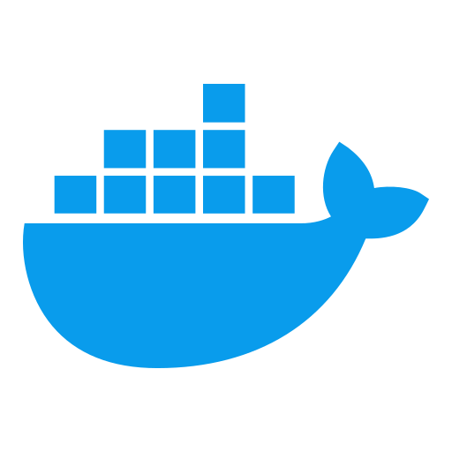

Tech Stack
Language- Java(Springboot) for backend and Jsp servlet,
Node-js for backend(User Authentrication) and html and css
Database- MySQL, MongoDB
IDE- Intelij
Version Control- Github

Slide 13
Objectives
To develop an e-commerce website using microservices architecture.
We have developed 5 microservices
Authentication Service
Product Service
Order Service
Inventory Service
Notification Service
Containerize each microservice with Docker to ensure portability, consistency, and optimal resource utilisation while leveraging containerization benefits such as segregated environments and version control.

Slide 14
Methodology
The application’s source code is developed in Java using the Integrated Development Environment (Eclipse/ NetBeans).
Containerize each microservice using Docker
Create Dockerfiles to specify container configurations and dependencies.
Build and test Docker images for each microservice.

Slide 15
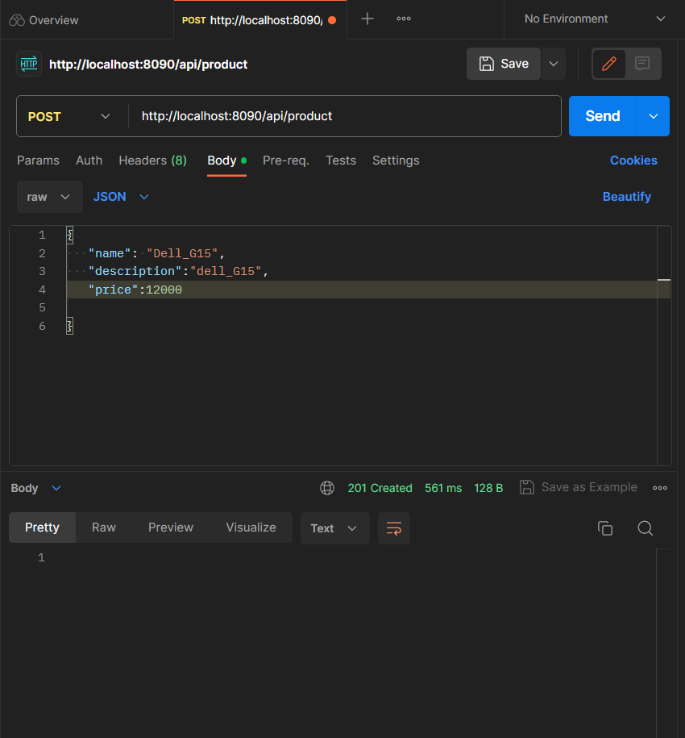
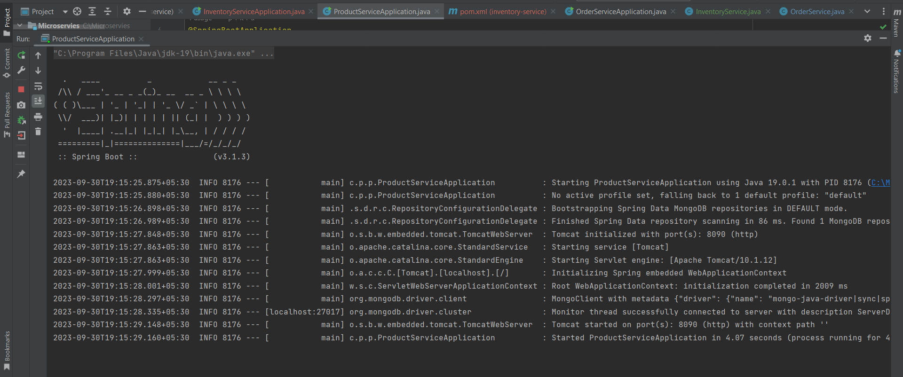
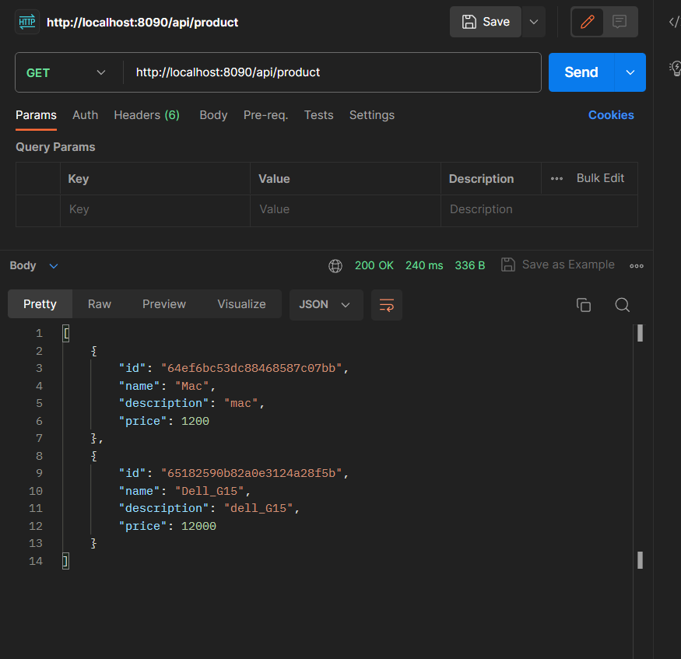
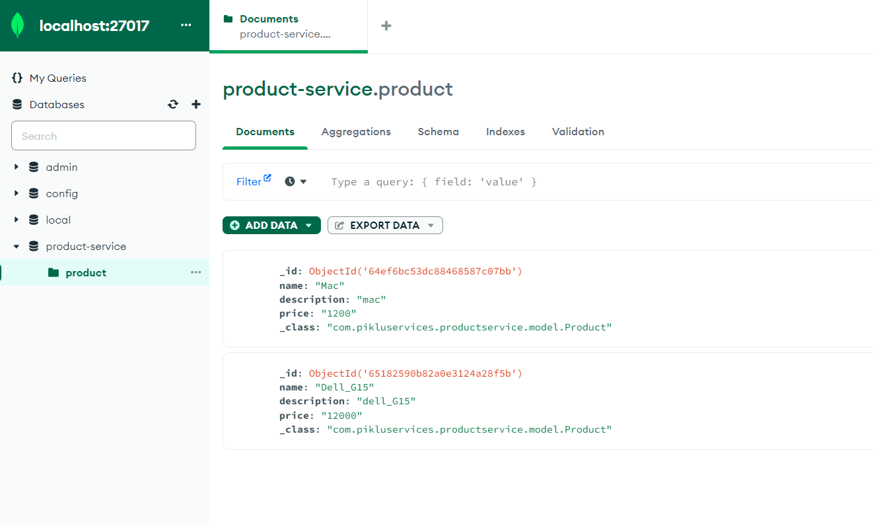
Microservices Images
PRODUCT-SERVICE
API

Slide 16
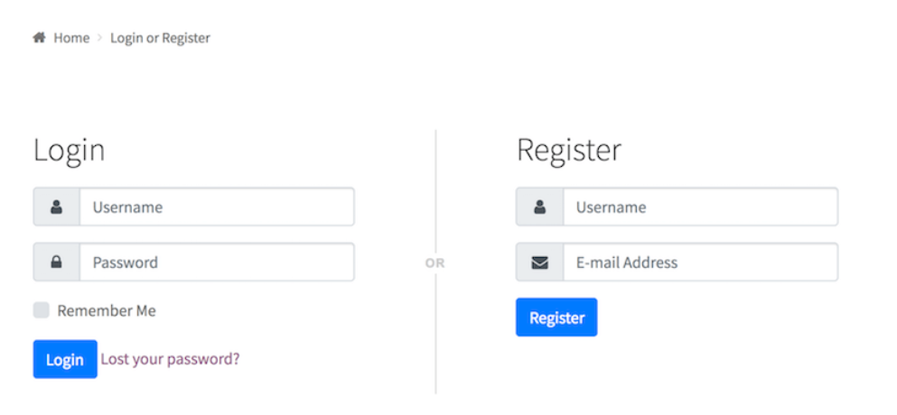
Frontend of microservice login page

Slide 17
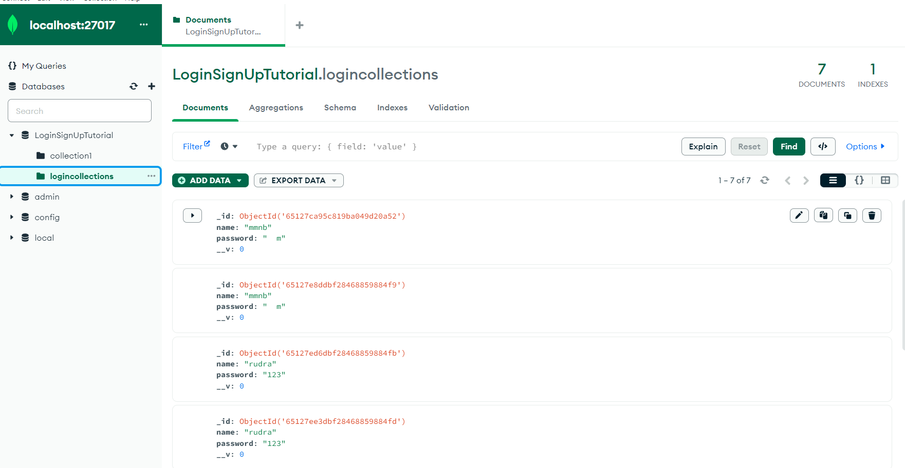
Database connection of Mongo Db

Slide 18
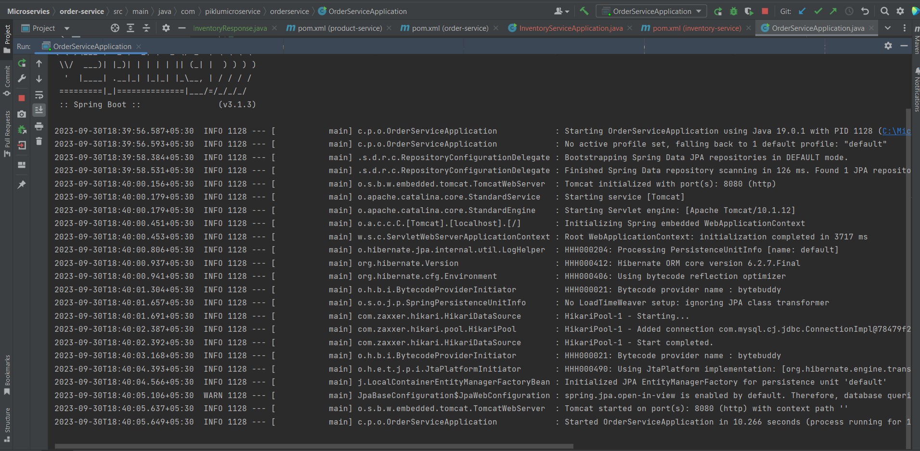
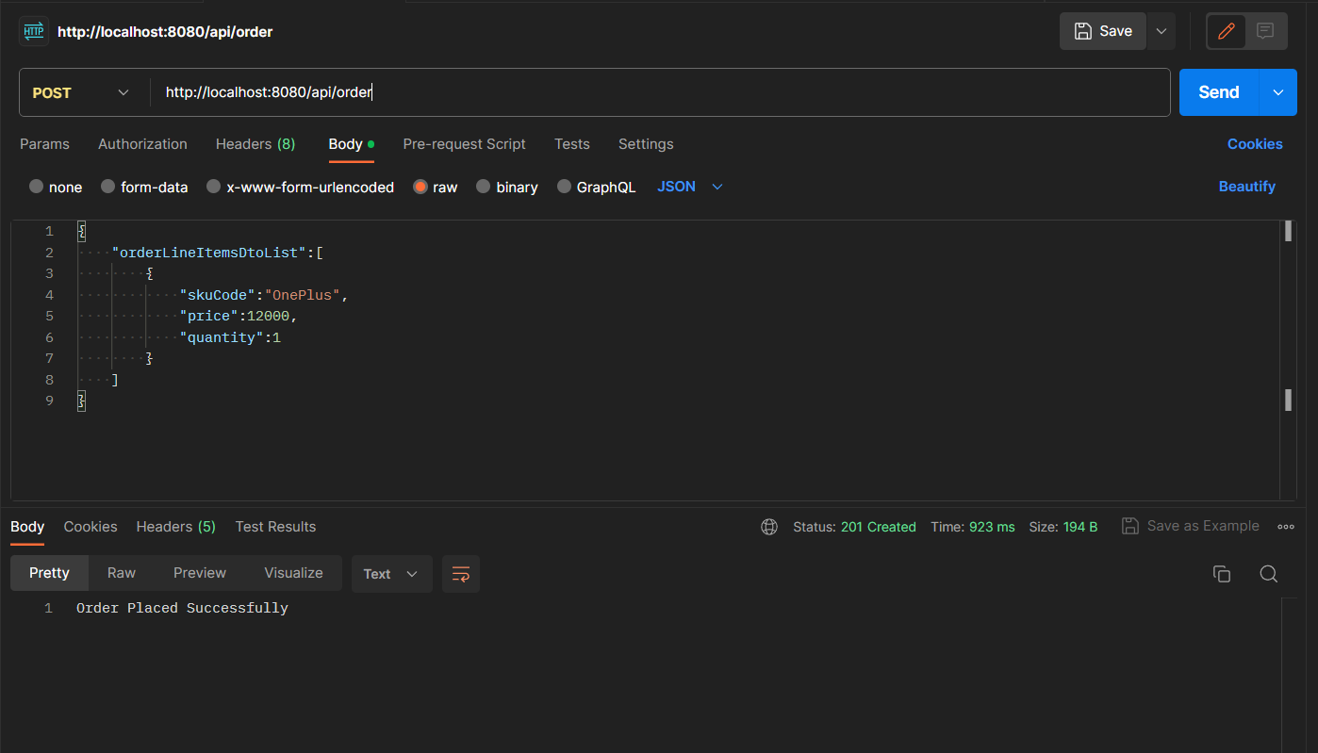
Microservices Images
ORDER-SERVICE
API

Slide 19
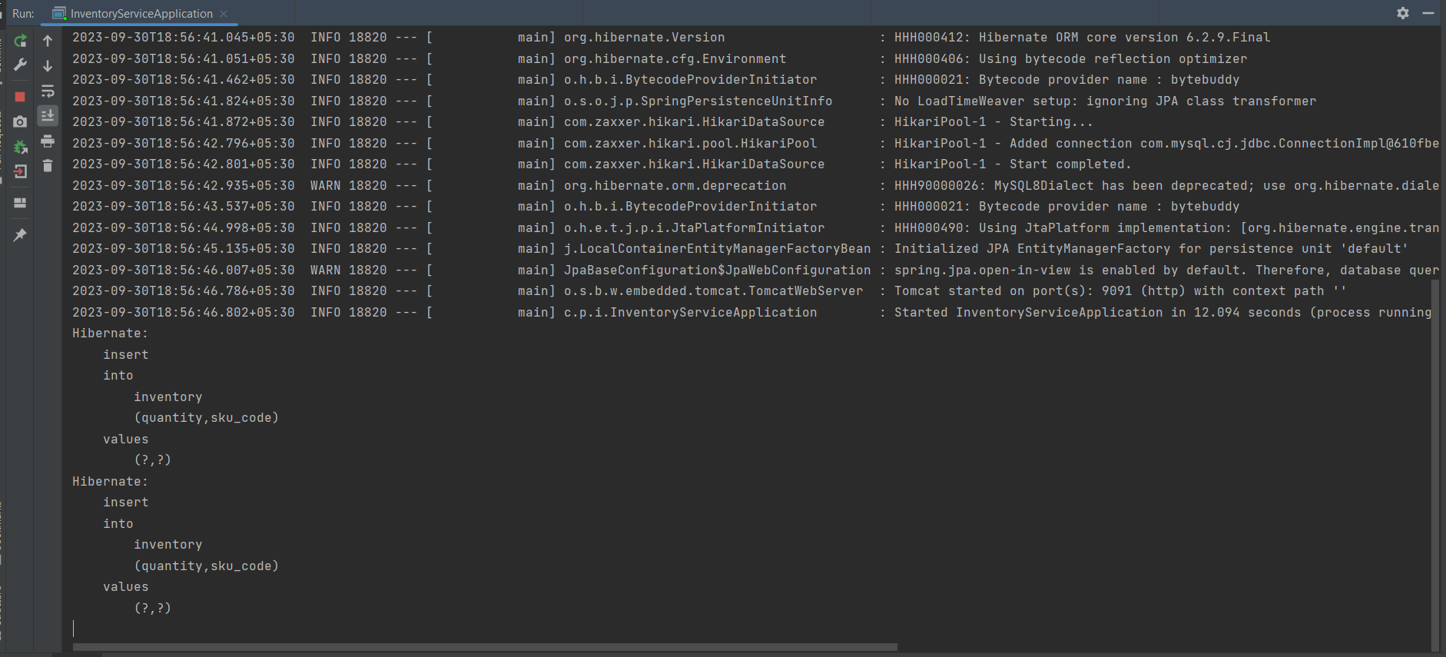
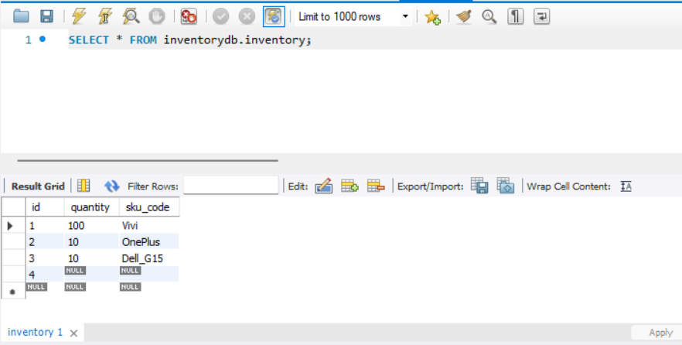
Microservices Images
INVENTORY-SERVICE
MySQL Database

Slide 20
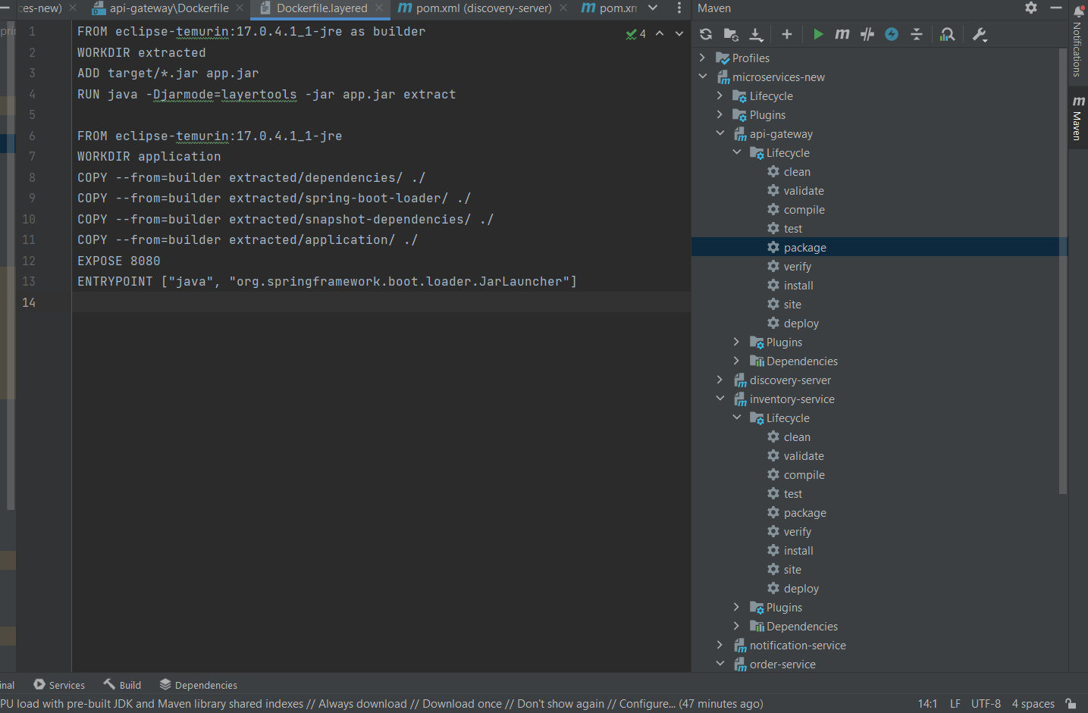
Dockerfile Image

Slide 21
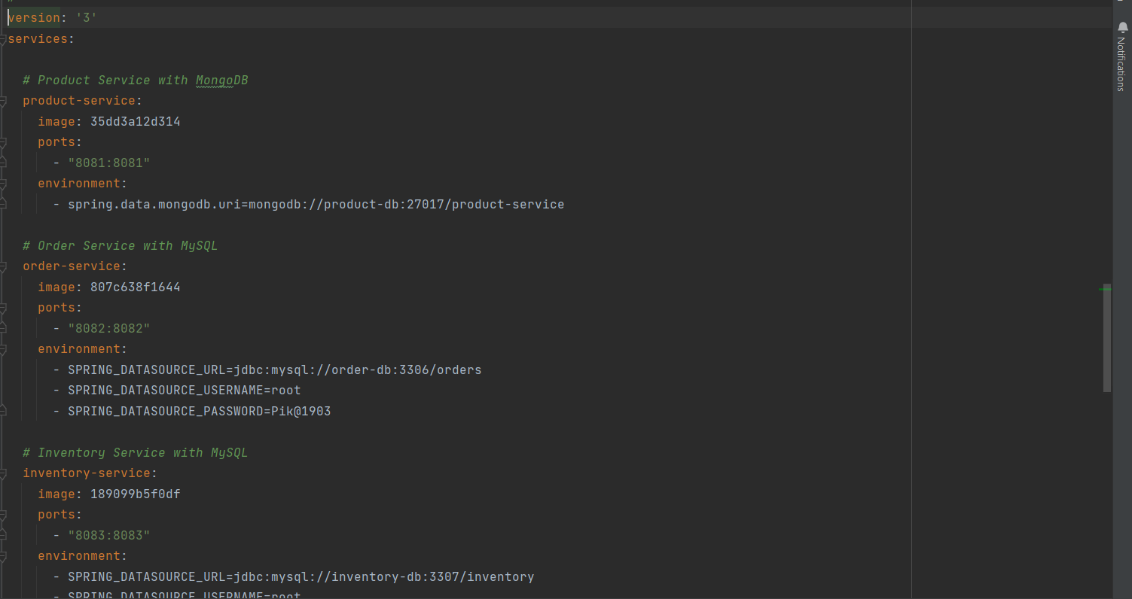
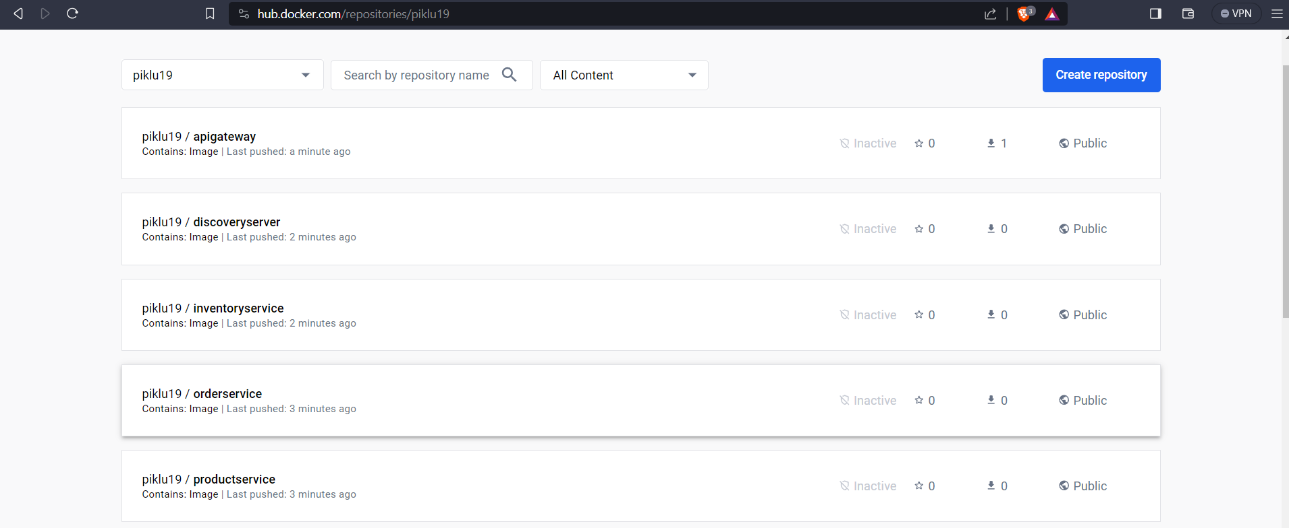
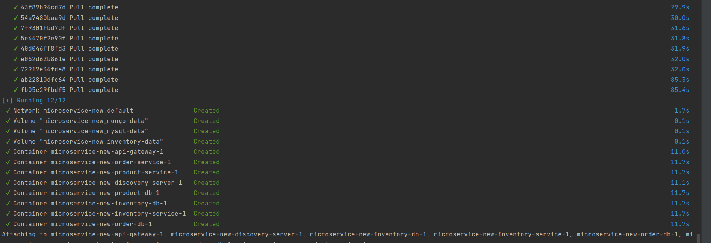
Dockerization
Compose file
Images push on to the docker hub
Successfully run compose file

Slide 22
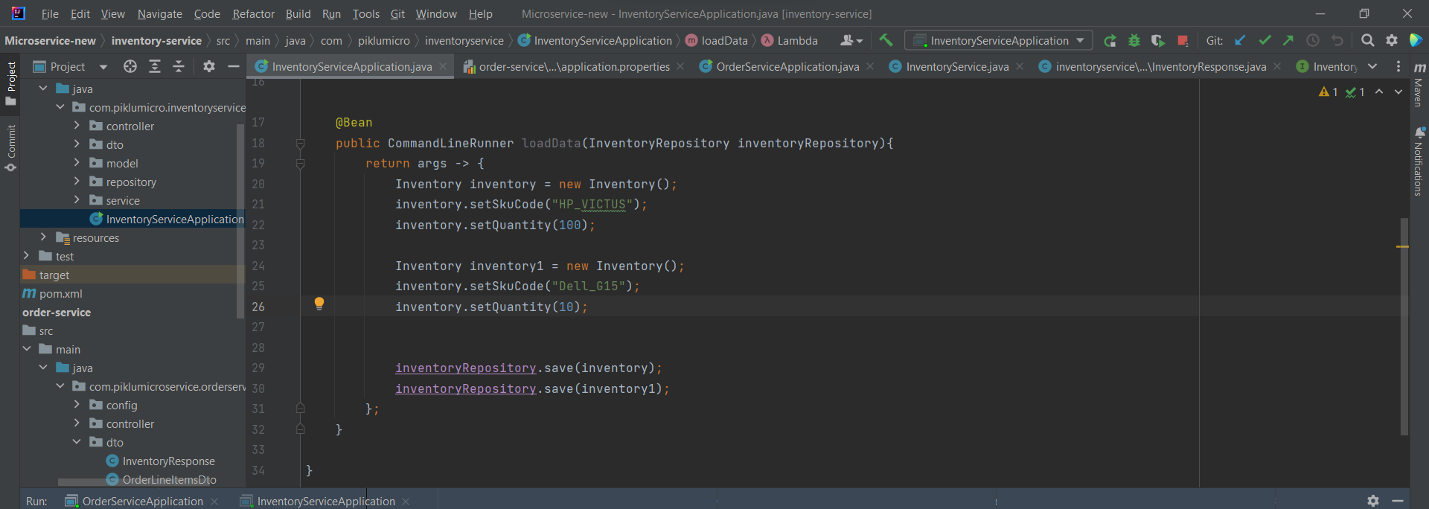
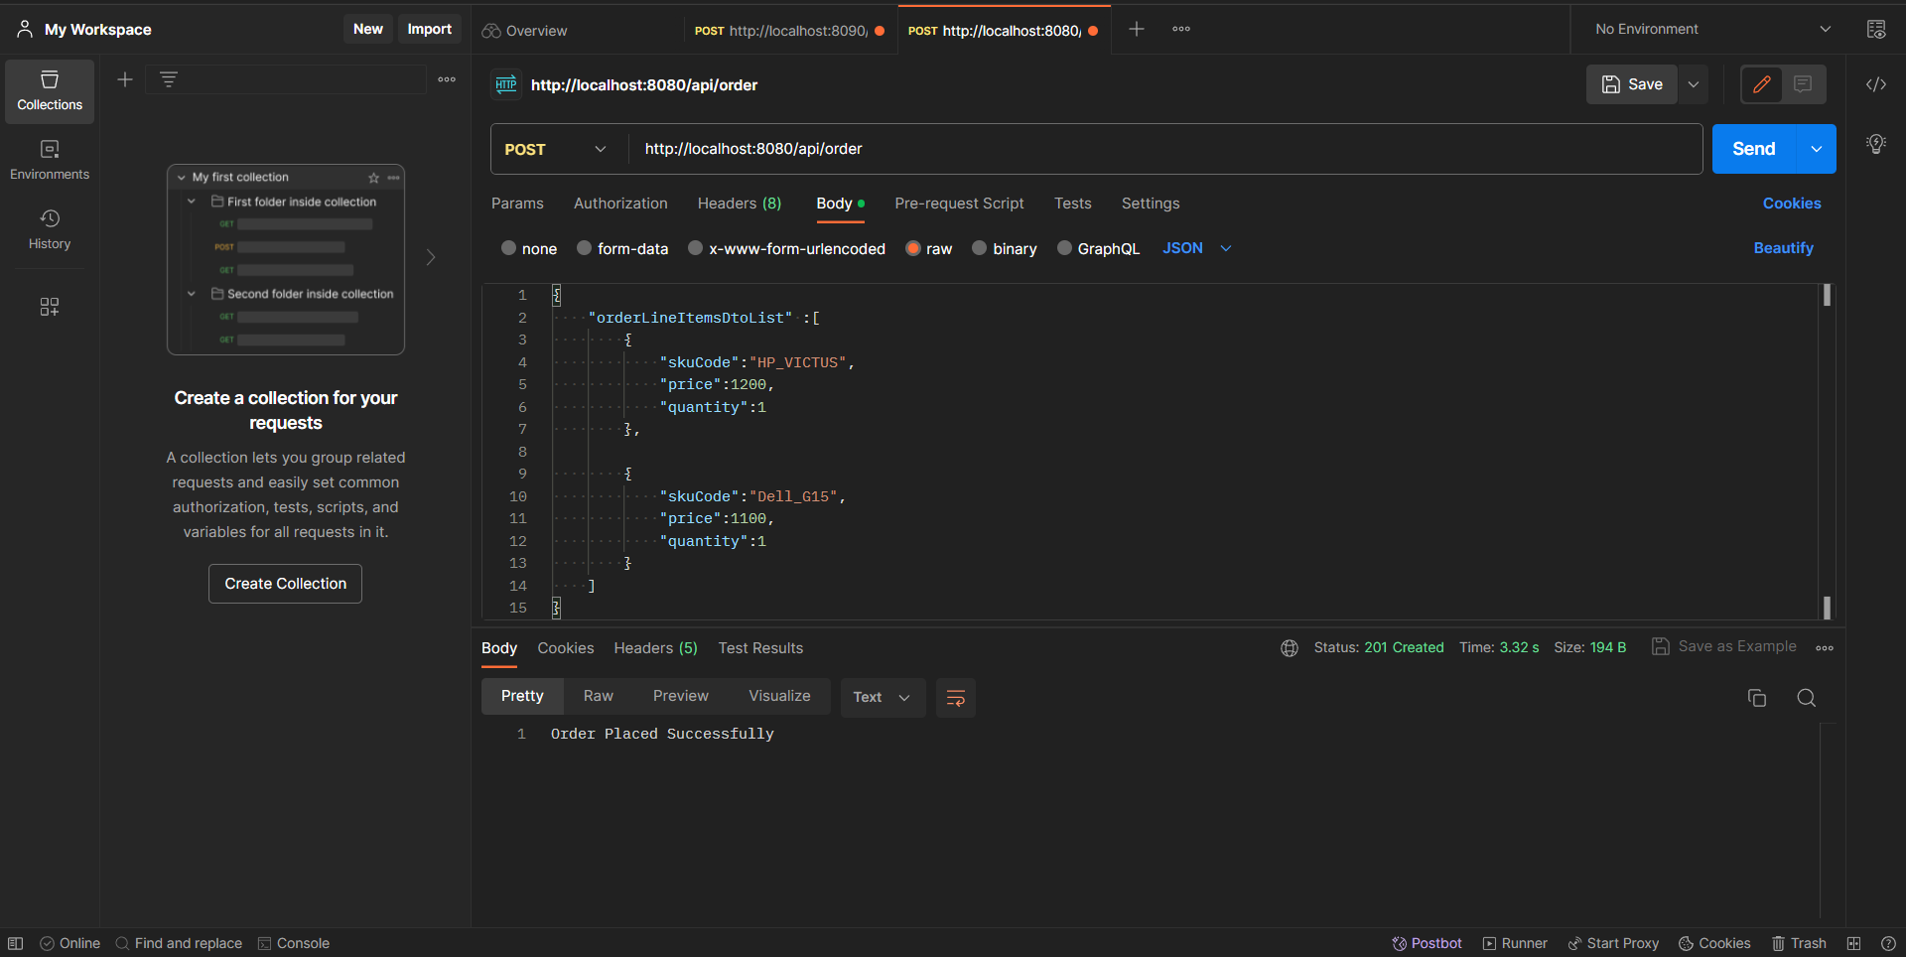
Microservices Images
Inventory Service have two products one is HP_VICTUS and Another one is Dell_G15. We have quantity set for HP_VICTUS is 100 and Dell_G15 10. Now we are Post request send to the order service
Inventory services
Successfully access with the help of Postman API

Slide 23
Why we used Docker ?
A platform and tools are provided by Docker to manage the lifespan of containers. It is an open source, dependable, and the most widely used container platform that enables the running of applications in a contained environment. We picked Docker for the following main reasons:
Ease of Use: Docker is simple to use and accessible to both developers and system administrators because to its nice command-line interface and graphical features. It streamlines the creation, administration, and operation of containers.
Portability: Across a variety of environments (development, testing, production, and cloud), Docker containers are incredibly portable.All dependencies are encapsulated by containers, guaranteeing constant behaviour regardless of the host system.
Isolation: Applications can operate independently without interfering with one another because to the strong isolation techniques provided by Docker containers.They isolate processes and resources using namespaces and cgroups.
DevOps Integration: By enabling developersBy enabling developers and operations teams to collaborate in standardised settings across the development lifecycle, Docker accelerates the adoption of DevOps practises. and operations teams to collaborate in standardised settings across the development lifecycle, Docker accelerates the adoption of DevOps practises.
Multi-Platform Support: Docker is adaptable for a variety of use cases since it supports several platforms, including Linux, Windows, and ARM.
Continuous Integration/Continuous Deployment (CI/CD): Docker containers can be easily integrated into CI/CD pipelines for automated testing, building, and deployment, improving the software development lifecycle.

Slide 24
How containers facilitate scalability and isolation?
Containers are lightweight and share the host OS kernel, reducing overhead compared to traditional virtualization. This enables more containers to run on a single host, making better use of available resources.
Containers can be easily replicated and orchestrated using container orchestration platforms like Kubernetes or Docker Swarm. This allows for dynamic scaling by adding or removing container instances based on demand.
Containers can be spun up or down quickly, reducing the time needed to deploy and scale applications. This agility is crucial for handling sudden increases in traffic.
Container orchestration platforms can automate scaling based on predefined metrics or thresholds, ensuring that the application can handle varying workloads without manual intervention.
Each container has its own isolated filesystem, which includes libraries, binaries, and application code. This isolation prevents conflicts and interference between different containers.
Containers can define and limit the amount of CPU, memory, and other system resources they can use. This prevents resource contention and ensures fair allocation among containers.

Slide 25
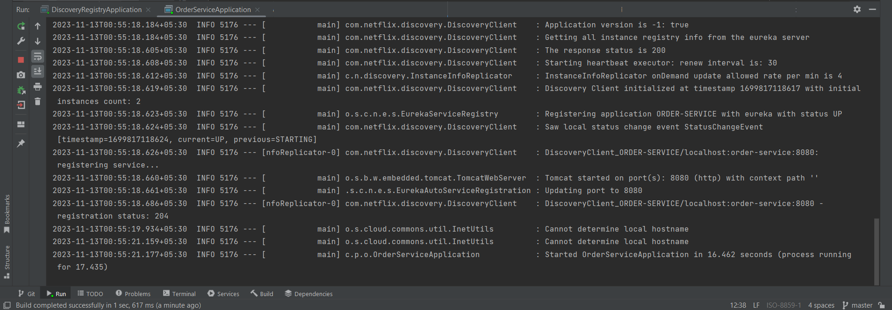
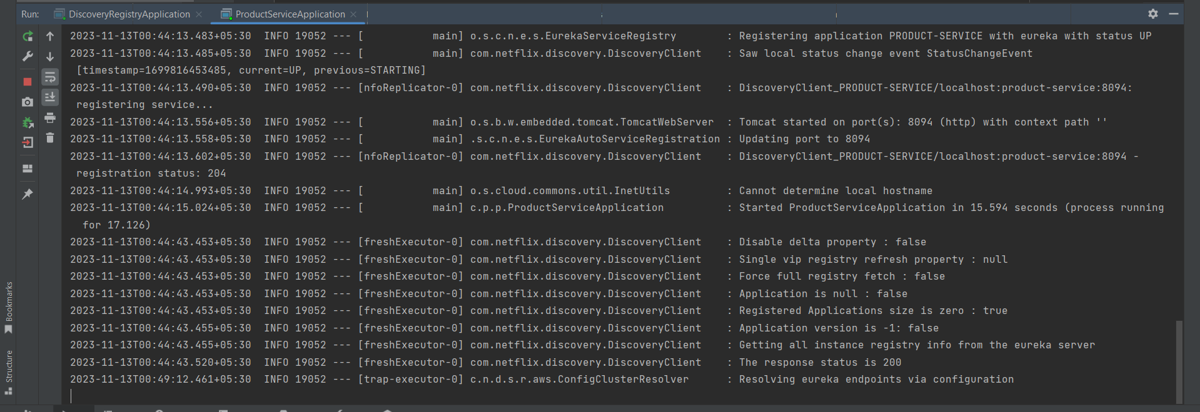
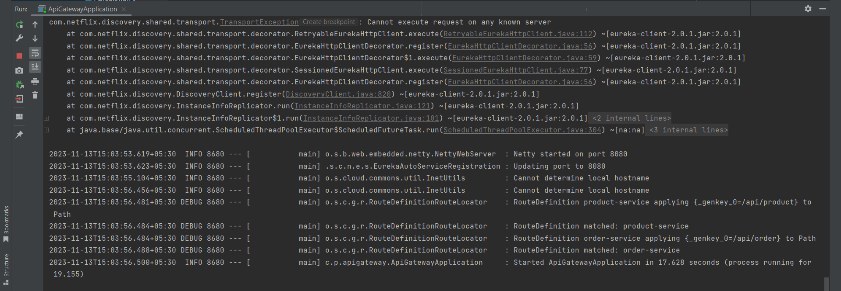
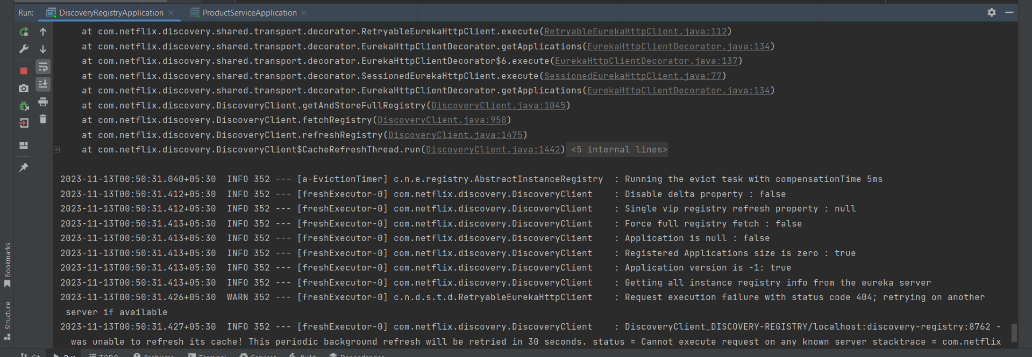
Uses Of Eureka Server
Eureka Server is an application that holds the information about all client-service applications. Every Micro service will register into the Eureka server and Eureka server knows all the client applications running on each port and IP address. Eureka Server is also known as Discover Server.
.
Inventory Service
Product Service
API GATEWAY SERVICE
Order service

Slide 26
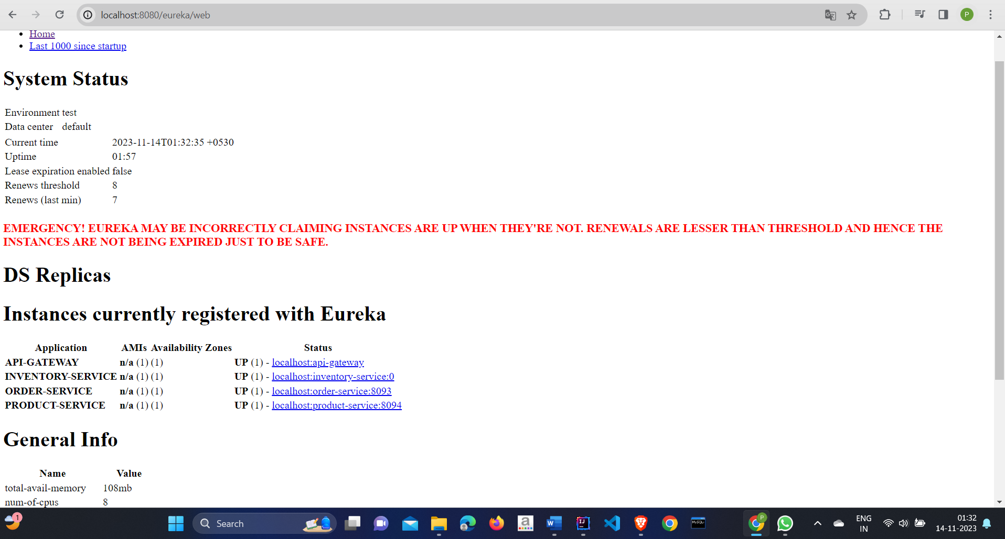
Uses Of Eureka Server
Eureka Server is an application that holds the information about all client-service applications. Every Micro service will register into the Eureka server and Eureka server knows all the client applications running on each port and IP address. Eureka Server is also known as Discover Server.
.
ALL services Add into the Eureka Services

Slide 27
Cloud Platform Comparition
 | AWS (Amazon Web Services) | Azure | Google Cloud
Strengths: | Comprehensive suite of cloud computing services, excellent support, and strong community backing. | Extensive services and tools, highly available and reliable. | Excellent support for machine learning and artificial intelligence applications.
Weaknesses: | Complex pricing model, can be expensive depending on usage. | Lacks support for some popular third-party tools and libraries. | Smaller user base compared to AWS and Azure, more niche services.
Fits: | Well with large-scale applications requiring extensive infrastructure management. | Appeals to organizations with an existing Microsoft ecosystem. | Best suited for organizations heavily investing in data analytics and AI technologies.

Slide 28
Comparison based on suitability of different microservice
Authentication and Authorization Microservice:
AWS:
Suitability: Amazon Cognito provides a fully managed authentication service, and AWS Identity and Access Management (IAM) can handle access control for AWS resources, making it suitable for an Authentication and Authorization Microservice.
Azure:
Suitability: Azure Active Directory is a comprehensive identity and access management service that can handle authentication and authorization needs for microservices in Azure.
Google Cloud:
Suitability: Cloud Identity Platform provides identity and access management services, making it suitable for handling authentication and authorization for microservices in Google Cloud.
Inventory Service:
AWS:
Suitability: AWS provides various services like AWS Lambda for serverless computing and Amazon DynamoDB for NoSQL database, which can be suitable for implementing an Inventory Service. AWS also offers managed container services like ECS and EKS for more complex scenarios.
Azure:
Suitability: Azure offers Azure Functions for serverless computing and Azure Cosmos DB for a globally distributed, multi-model database, which can be well-suited for an Inventory Service. Azure Kubernetes Service (AKS) can handle containerized workloads.
Google Cloud:
Suitability: Google Cloud provides Cloud Functions for serverless computing and Cloud Firestore for a NoSQL database, making it suitable for the Inventory Service. Google Kubernetes Engine (GKE) can be used for container orchestration.

Slide 29
Product Service:
AWS:
Suitability: AWS Lambda and Amazon DynamoDB can be utilized for a serverless and scalable Product Service. AWS also offers managed services for relational databases like Amazon RDS.
Azure:
Suitability: Azure Functions and Azure Cosmos DB are suitable for a serverless and globally distributed Product Service. Azure SQL Database is available for relational data storage.
Google Cloud:
Suitability: Cloud Functions and Cloud Firestore can be used for a serverless and scalable Product Service. Google Cloud also provides Cloud SQL for relational database needs.
Order Service:
AWS:
Suitability: AWS Lambda and Amazon DynamoDB can be leveraged for a serverless and scalable Order Service. AWS Step Functions can be useful for orchestrating complex workflows.
Azure:
Suitability: Azure Functions and Azure Cosmos DB are suitable for a serverless and globally distributed Order Service. Azure Logic Apps can help in orchestrating workflows.
Google Cloud:
Suitability: Cloud Functions and Cloud Firestore can be utilized for a serverless and scalable Order Service. Google Cloud Composer can be used for workflow orchestration.
Notification Service:
AWS:
Suitability: AWS Simple Notification Service (SNS) and AWS Lambda can be used for a scalable and serverless Notification Service. SNS supports various messaging protocols.
Azure:
Suitability: Azure Event Grid and Azure Functions are suitable for building event-driven Notification Services. Azure Notification Hubs can be used for mobile push notifications.
Google Cloud:
Suitability: Cloud Pub/Sub and Cloud Functions can be utilized for building a scalable and serverless Notification Service. Firebase Cloud Messaging (FCM) can be used for mobile push notifications.

Slide 30
Container Orchestration
Container orchestration is the process of automating the deployment, scaling, and management of containerized applications. Containers are lightweight, portable, and consistent environments that encapsulate an application and its dependencies. However, when dealing with large and complex systems composed of numerous containers, managing them manually becomes challenging. Container orchestration tools automate these processes to simplify and streamline the overall management of containerized applications.
How container orchestration simplifies deployment, scaling, and management.
Efficiency and Consistency:
Orchestration ensures consistency in deploying applications across various environments, reducing errors and ensuring that the application behaves the same way in development, testing, and production.
Automated Scaling:
Container orchestration tools automate the scaling of applications based on demand. This responsiveness allows applications to efficiently handle varying workloads without manual intervention.
Improved Resource Utilization:
By automatically managing resource allocation, container orchestration platforms optimize infrastructure usage, reducing costs and improving overall efficiency.
Simplified Updates and Rollbacks:
Orchestrators streamline the process of updating applications, making it easier to roll out new features or bug fixes. Automated rollbacks ensure that issues can be quickly addressed without significant downtime.
Enhanced Availability and Reliability:
The self-healing capabilities of container orchestration platforms enhance the availability and reliability of applications by automatically recovering from failures.
Streamlined Operations:
Orchestration simplifies complex operational tasks, allowing development and operations teams to focus more on building and improving applications rather than dealing with the intricacies of managing individual containers.

Slide 31
Github Link-
https://github.com/p-i-k-l-u/Microservices-Project

Slide 32
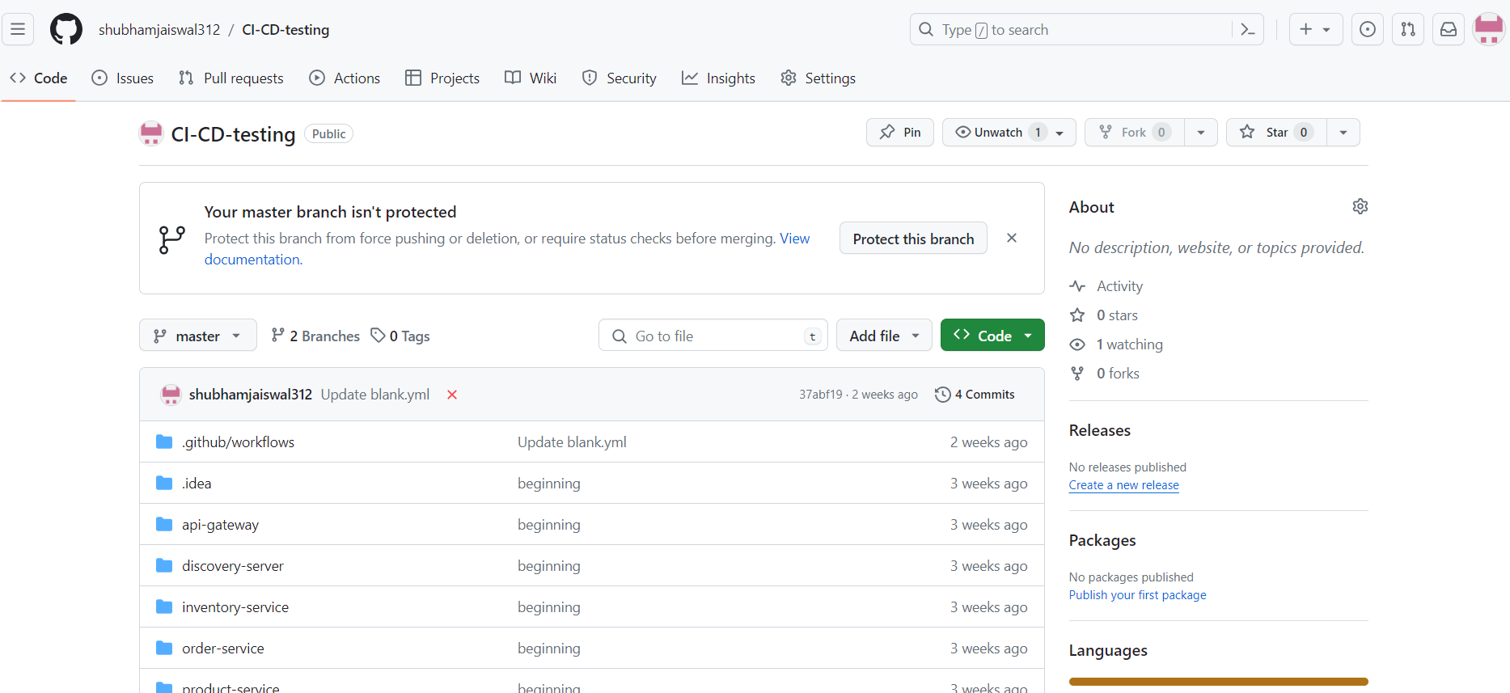
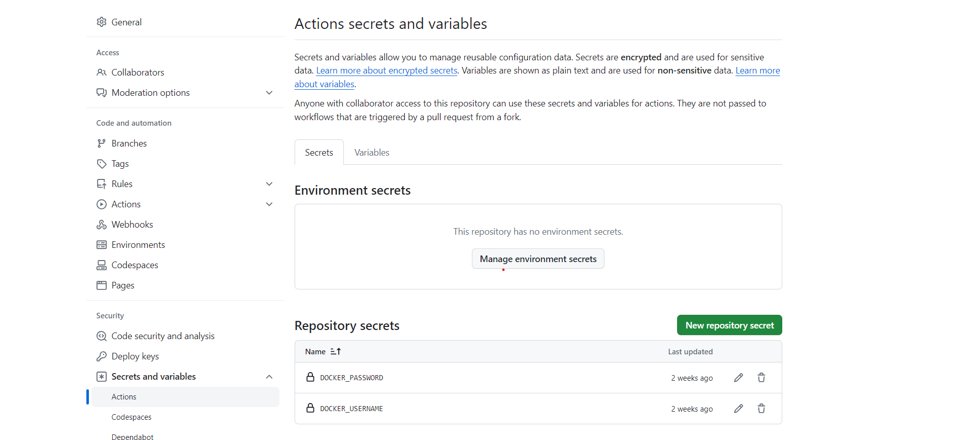
Creating Ci/Cd Pipeline

Slide 33
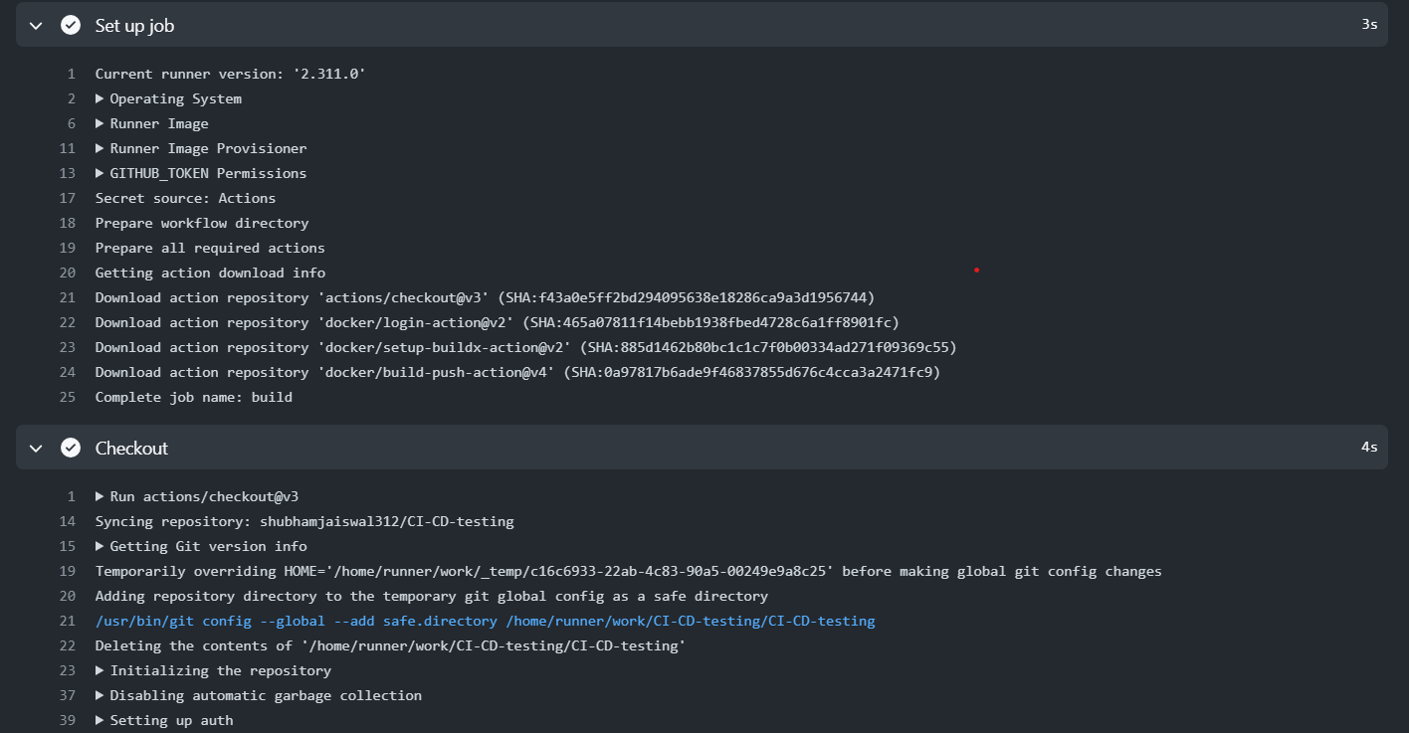
Building The Workflow

Slide 34
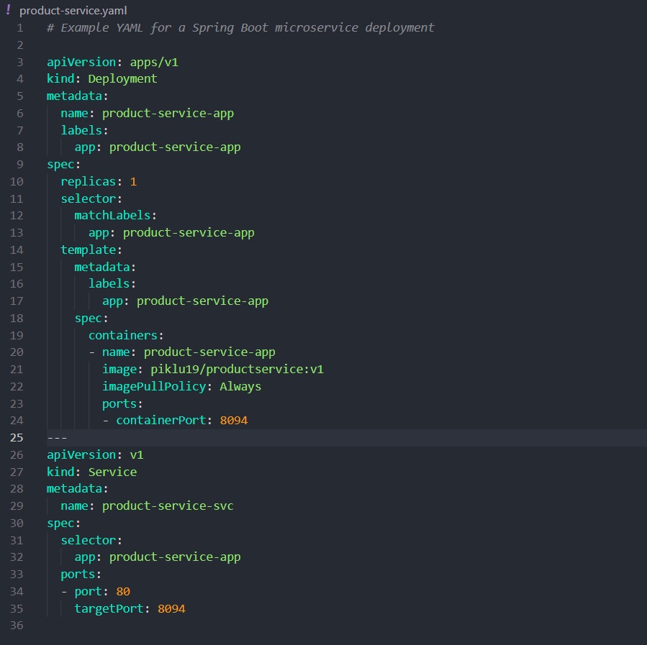
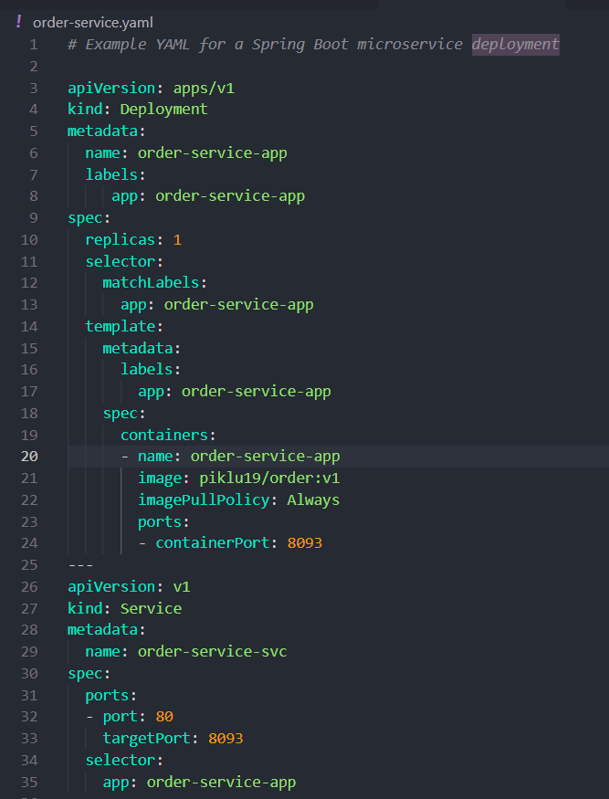
Create Configuration file

Slide 35
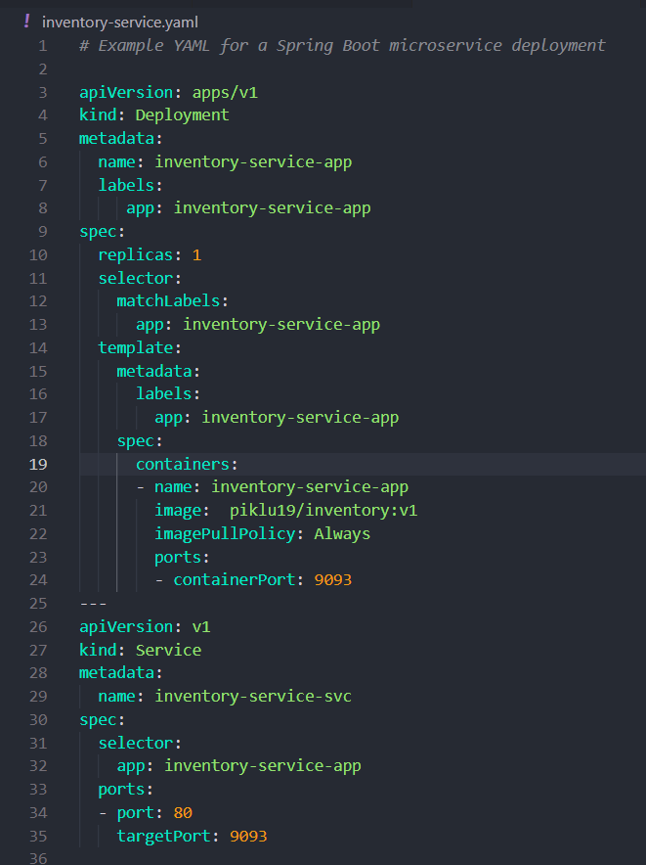
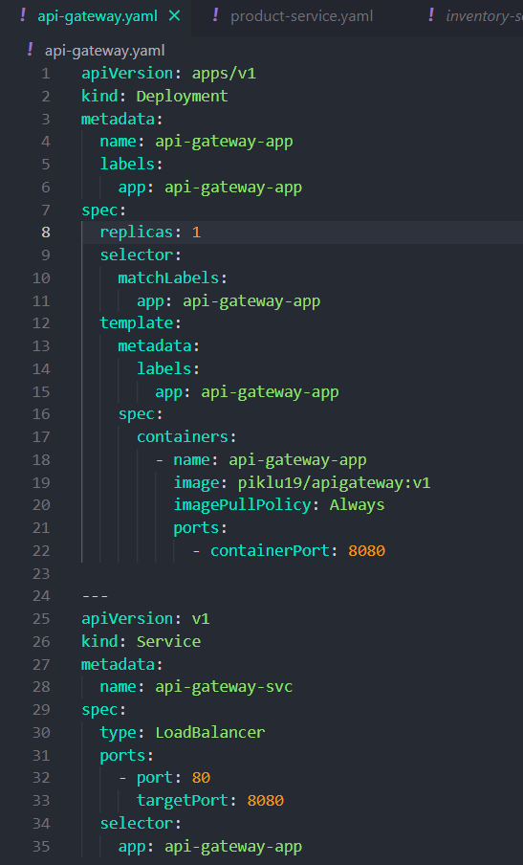
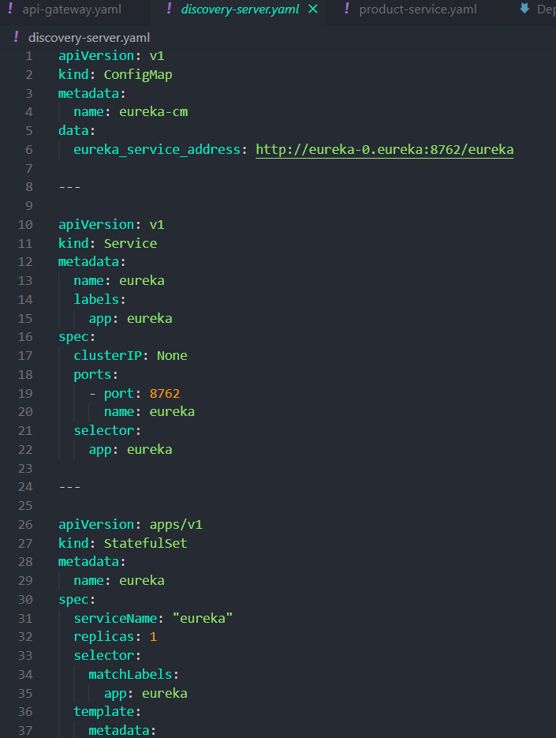
Create Configuration file

Slide 36
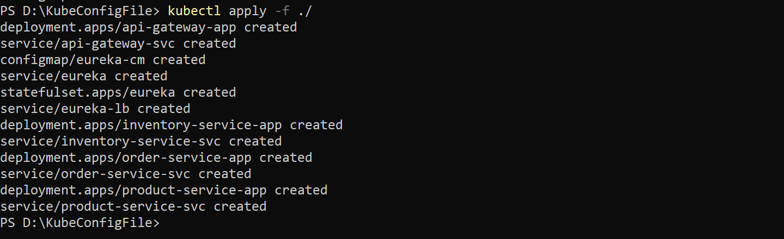
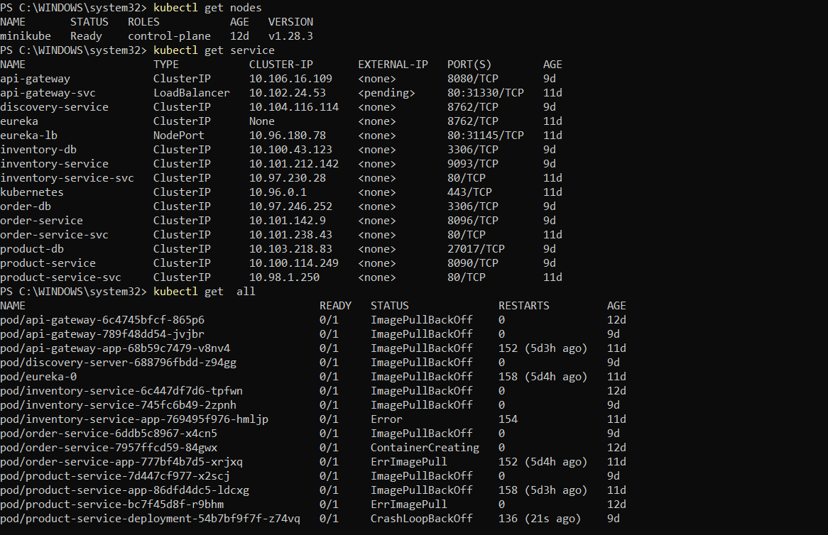
Deployment Process
Using Minikube

Slide 37
Scaling and load balancing
Scaling in AWS EKS:
Horizontal Pod Autoscaling (HPA):
Kubernetes provides Horizontal Pod Autoscaling, allowing the number of pods (containers) in a deployment to automatically scale based on defined metrics like CPU utilization or custom metrics. EKS integrates with HPA to automatically adjust the number of pods in response to changing demand.
Cluster Autoscaler:
EKS supports the Kubernetes Cluster Autoscaler, which automatically adjusts the size of the cluster by adding or removing nodes based on resource requirements and constraints. This ensures optimal utilization of resources and accommodates varying workloads.
Node Groups:
EKS allows you to create and manage node groups, which are a set of Amazon EC2 instances that host Kubernetes pods. You can scale node groups manually or use the Cluster Autoscaler to adjust the number of nodes dynamically.
Load Balancing in AWS EKS:
Amazon EKS Integrated Load Balancer:
EKS integrates with the Application Load Balancer (ALB) or Network Load Balancer (NLB) in AWS. When you deploy services in EKS, you can expose them through the Amazon EKS integrated load balancer, which automatically creates and configures the necessary AWS resources.
Service Load Balancing:
Kubernetes Services abstract the underlying pods, and EKS provides native integration with AWS load balancers to expose services. This can include both internal and external services, and load balancers distribute traffic across the pods associated with the service.
Ingress Controllers:
EKS allows you to deploy Ingress controllers, such as the AWS ALB Ingress Controller, to manage external access to services. Ingress controllers route external traffic to the appropriate services within the EKS cluster.
Elastic Load Balancer (ELB):
EKS supports both Application Load Balancers (ALB) and Network Load Balancers (NLB) for routing traffic to services. You can create and configure ELBs through the AWS Management Console or by using Infrastructure as Code (IaC) tools like AWS CloudFormation.

Slide 38
Monitoring and Logging
Monitoring in AWS EKS:
Amazon CloudWatch:
Container Insights: AWS offers Container Insights for Amazon EKS, which provides visibility into the performance and health of your EKS cluster, nodes, and containers. It collects and aggregates metrics such as CPU and memory utilization, network performance, and more.
Custom Metrics: You can publish custom metrics from your applications to CloudWatch, allowing you to monitor specific aspects of your services. These metrics can be used for autoscaling and to set up alarms.
AWS CloudWatch Alarms:
Set up CloudWatch Alarms to be notified when certain thresholds are breached. Alarms can trigger actions, such as sending notifications or automatically adjusting the desired number of nodes in a node group.
Kubernetes Dashboard:
Use the Kubernetes Dashboard to get insights into the state of your EKS cluster. You can view information about nodes, pods, services, and deployments directly from the Kubernetes API.
Prometheus and Grafana:
EKS supports integrating Prometheus and Grafana for monitoring. You can deploy Prometheus to collect metrics from your cluster and use Grafana to create dashboards for visualization.

Slide 39
Logging in AWS EKS:
Amazon CloudWatch Logs:
Kubernetes components, as well as applications running on EKS, generate logs that can be collected and stored in Amazon CloudWatch Logs. You can use the kubectl logs command to retrieve container logs.
Fluentd Integration: EKS clusters use Fluentd as the logging agent to collect, process, and forward logs to CloudWatch Logs. Fluentd is pre-configured on worker nodes.
AWS CloudWatch Container Insights:
CloudWatch Container Insights not only provides metrics but also collects, aggregates, and displays logs from your containers. It provides a unified view of performance data and logs.
Amazon EKS Control Plane Logs:
EKS generates control plane logs that capture API calls and other activities. These logs are stored in Amazon CloudWatch Logs and can be used for auditing and troubleshooting.
Elasticsearch and Kibana:
For more advanced log analytics and visualization, you can set up Elasticsearch and Kibana. This can be beneficial for large-scale log analysis and troubleshooting.

Slide 40
TEAM MEMBERS AND THEIR ROLES
SL. NO | NAME | SAP ID | ROLE
1. | Rudraksh Bhatnagar | 500096351 | Frontend, Microservices, CICD, Documentation, Containerization
2. | Piklu De | 500096448 | Microservices, Documentation, Dockerization Containerization, Deployment
3. | Shubham Jaiswal | 500096554 | Microservices, CICD, Documentation, Dockerization Containerization, Deployment
4. | Chetanshi Pandey | 500096288 | Documentation, Dockerization, Microservices(Inventory Services)
5. | Parth Singh | 500096616 | Documentation, Dockerization, Microservices(Inventory Service)

